Slide 1
Chapter 16
Wave Motion

Slide 2
Types of Waves
Example of a wave
  A pebble hits the water’s surface.
  The resulting circular wave moves outward from the creation point.
  An object floating on the disturbed water will move vertically and horizontally about its original position, but does not undergo any net displacement.
There are two main types of waves.
  Mechanical waves
    Some physical medium is being disturbed.
    The wave is the propagation of a disturbance through a medium.
  Electromagnetic waves
    No medium required.
    Examples are light, radio waves, x-rays
Introduction

Slide 3
General Features of Waves
In wave motion, energy is transferred over a distance.
Matter is not transferred over a distance.
Introduction

Slide 4
Mechanical Wave Requirements
Some source of disturbance
A medium containing elements that can be disturbed
Some physical mechanism through which elements of the medium can influence each other
Section 16.1

Slide 5
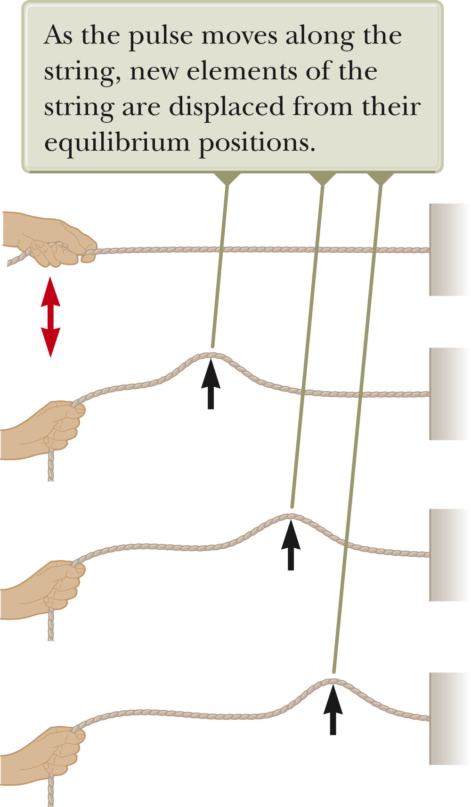
Pulse on a String
The wave is generated by a flick on one end of the string.
The string is under tension.
A single bump is formed and travels along the string.
  The bump is called a pulse.
The diagram shows “snapshots” of the creation and propagation of the traveling pulse.
Section 16.1

Slide 6
Pulse on a String
The hand is the source of the disturbance.
The string is the medium through which the pulse travels.
  Individual elements of the string are disturbed from their equilibrium position.
  The elements are connected together so they influence each other.
The pulse has a definite height.
The pulse has a definite speed of propagation along the medium.
The shape of the pulse changes very little as it travels along the string.
Section 16.1

Slide 7
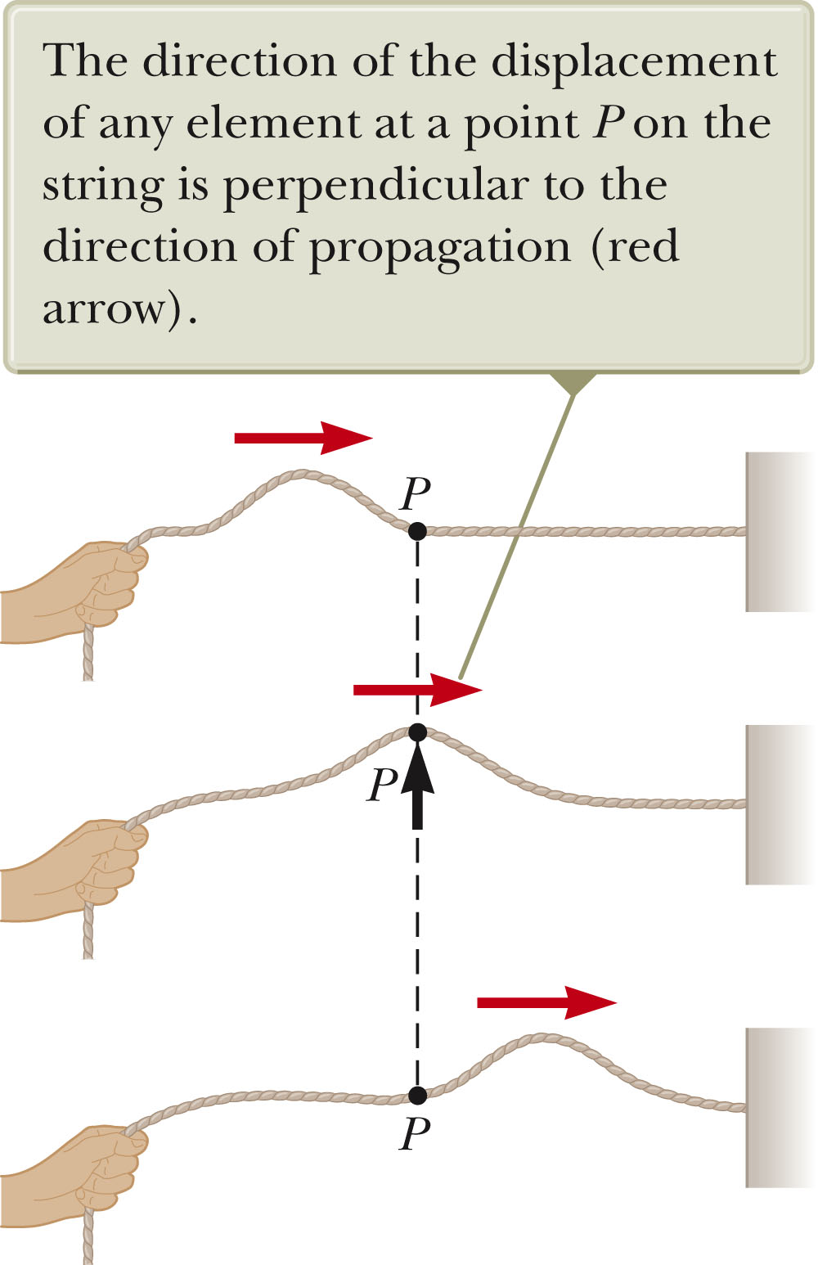
Transverse Wave
A wave is a periodic disturbance traveling through a medium.
A traveling wave or pulse that causes the elements of the disturbed medium to move perpendicular to the direction of propagation is called a transverse wave.
  To create the wave, you would move the end of the string up and down repeatedly.
The particle motion is shown by the blue arrow.
The direction of propagation is shown by the red arrow.
Section 16.1

Slide 8
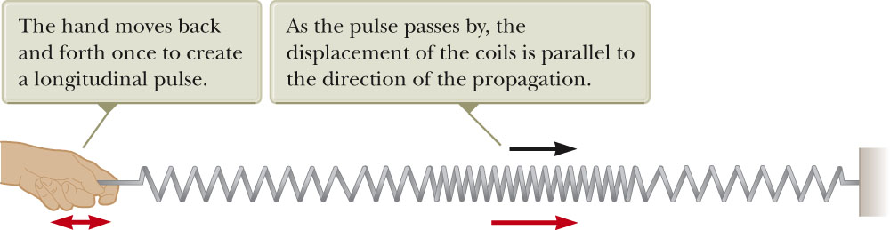
Longitudinal Wave
A traveling wave or pulse that causes the elements of the disturbed medium to move parallel to the direction of propagation is called a longitudinal wave.
  Sound waves are another example of longitudinal waves.
The displacement of the coils is parallel to the propagation.
Section 16.1

Slide 9
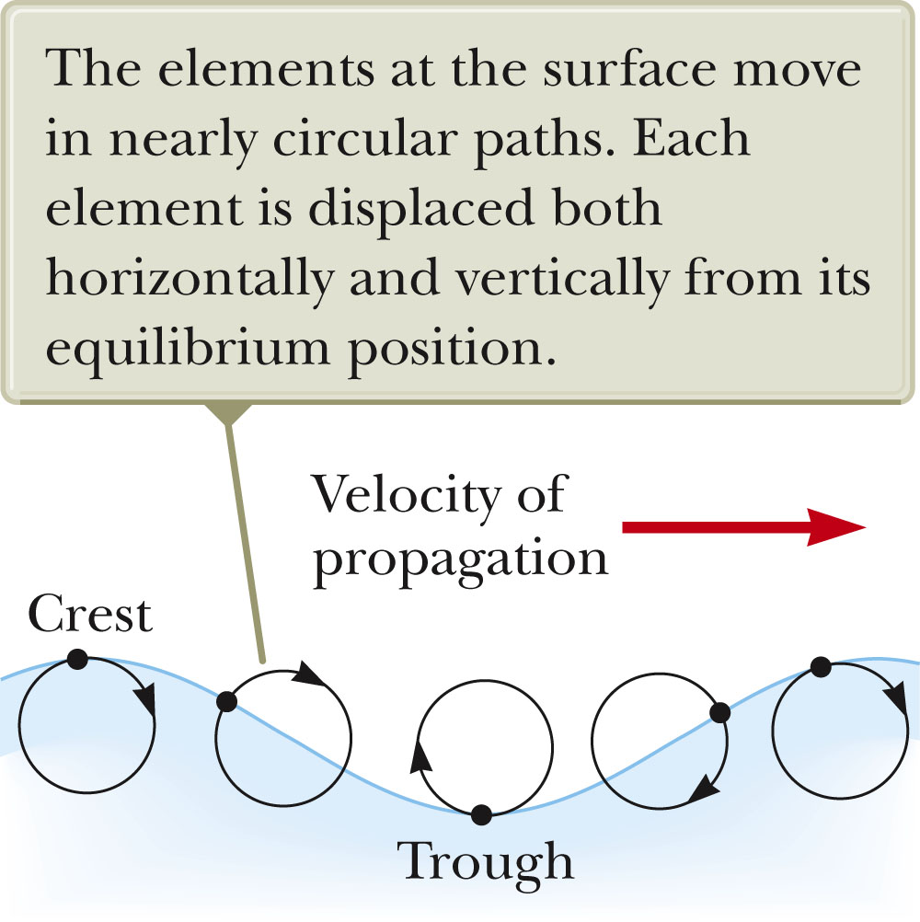
Complex Waves
Some waves exhibit a combination of transverse and longitudinal waves.
Surface water waves are an example.
  The elements of water at the surface move in nearly circular paths.
  The disturbance has both transverse and longitudinal components.
Section 16.1

Slide 10
Example: Earthquake Waves
P waves
  “P” stands for primary
  Fastest, at 7 – 8 km / s
  Longitudinal
S waves
  “S” stands for secondary
  Slower, at 4 – 5 km/s
  Transverse
A seismograph records the waves and allows determination of information about the earthquake’s place of origin.
Section 16.1

Slide 11
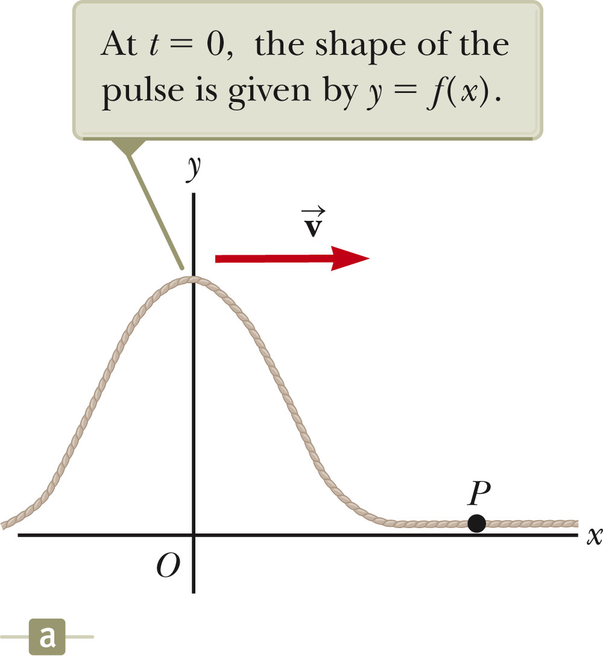
Traveling Pulse
The shape of the pulse at t = 0 is shown.
The shape can be represented by some mathematical function, y (x,0) = f (x).
  This describes the transverse position y of the element of the string located at each value of x at t = 0.
Section 16.1

Slide 12
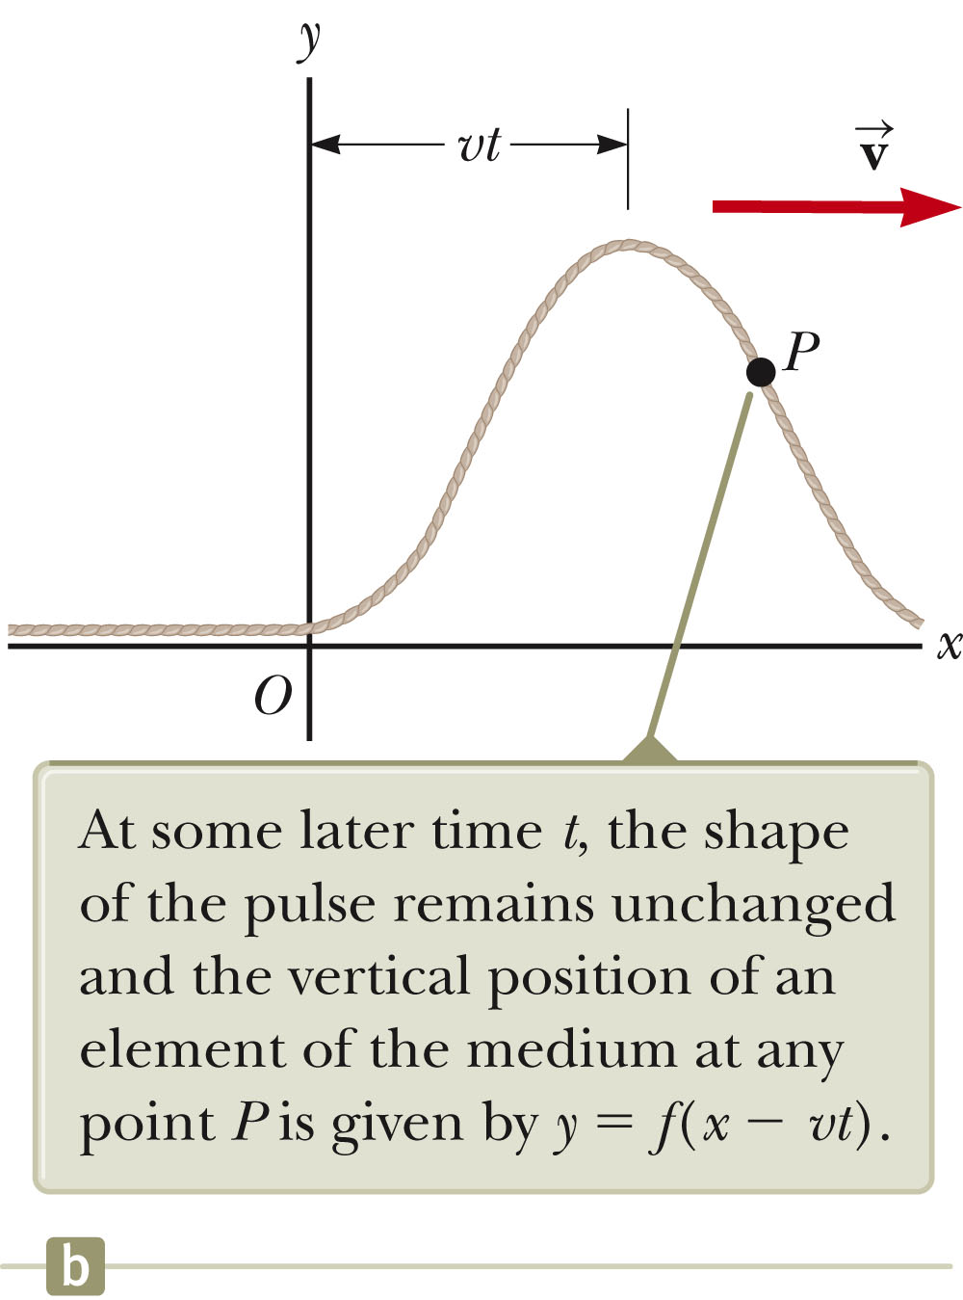
Traveling Pulse, cont.
The speed of the pulse is v.
At some time, t, the pulse has traveled a distance v t.
The shape of the pulse does not change with time.
Its vertical position is now y = f (x – vt).
Section 16.1

Slide 13
Traveling Pulse, final
For a pulse traveling to the right
  y (x, t) = f (x – vt)
For a pulse traveling to the left
  y (x, t) = f (x + vt)
The function y is also called the wave function: y (x, t).
The wave function represents the y coordinate of any element located at position x at any time t.
  The y coordinate is the transverse position.
If t is fixed then the wave function is called the waveform.
  It defines a curve representing the geometric shape of the pulse at that time.
Section 16.1

Slide 14
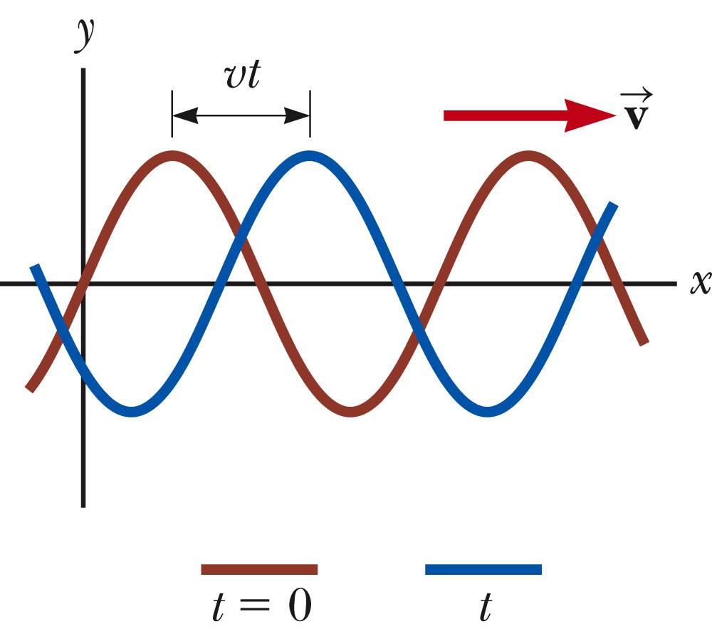
Sinusoidal Waves
The wave represented by the curve shown is a sinusoidal wave.
It is the same curve as sin θ plotted against θ.
This is the simplest example of a periodic continuous wave.
  It can be used to build more complex waves.
Section 16.2

Slide 15
Sinusoidal Waves, cont
The wave moves toward the right.
  In the previous diagram, the brown wave represents the initial position.
  As the wave moves toward the right, it will eventually be at the position of the blue curve.
Each element moves up and down in simple harmonic motion.
  This is the motion of the elements of the medium.
It is important to distinguish between the motion of the wave and the motion of the elements of the medium.
Section 16.2

Slide 16
Wave Model
The wave is a new simplification model.
  Allows us to explore more analysis models for solving problems.
  An ideal wave has a single frequency.
  An ideal wave is infinitely long.
  Ideal waves can be combined to build complex waves.
Analysis model of a traveling wave
  This model is used in situations in which a wave moves through space without interacting with other waves or particles.
Section 16.2

Slide 17
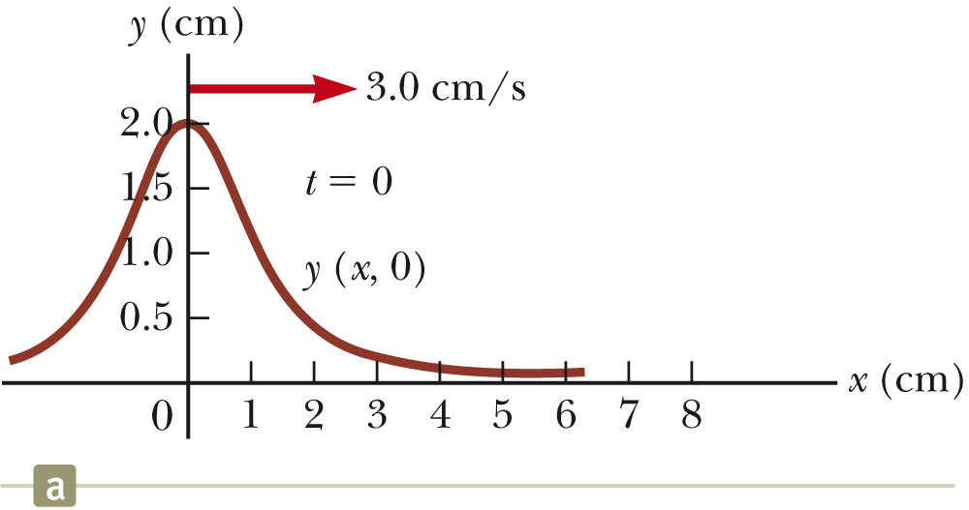
Terminology: Amplitude and Wavelength
The crest of the wave is the location of the maximum displacement of the element from its normal position.
  This distance is called the amplitude, A.
The wavelength, λ, is the distance from one crest to the next.
  More generally, the wavelength is the minimum distance between any two identical points on adjacent waves.
Section 16.2

Slide 18
Terminology: Period and Frequency
The period, T , is the time interval required for two identical points of adjacent waves to pass by a point.
  The period of the wave is the same as the period of the simple harmonic oscillation of one element of the medium.
The frequency, ƒ, is the number of crests (or any point on the wave) that pass a given point in a unit time interval.
  The time interval is most commonly the second.
  The frequency of the wave is the same as the frequency of the simple harmonic motion of one element of the medium.
Section 16.2

Slide 19
Terminology: Period and Frequency, cont
The frequency and the period are related.
When the time interval is the second, the units of frequency are s⁻¹ = Hz.
  Hz is a hertz
Section 16.2

Slide 20
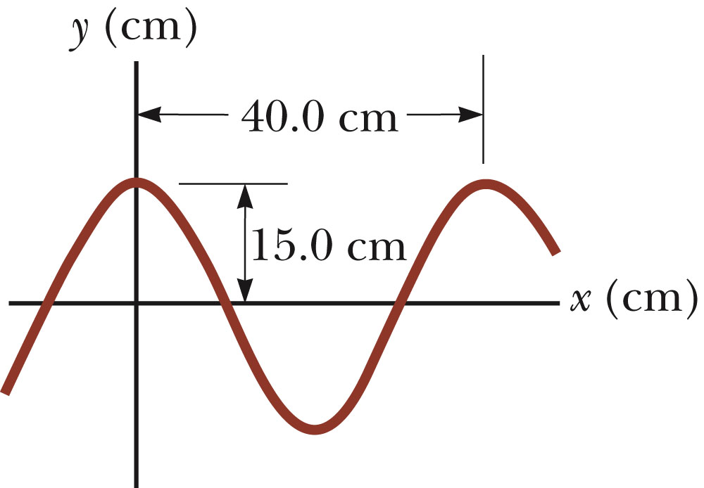
Terminology, Example
The wavelength, λ, is 40.0 cm
The amplitude, A, is 15.0 cm
The wave function can be written in the form y = A cos(kx – ωt).
Section 16.2

Slide 21
Speed of Waves
Waves travel with a specific speed.
  The speed depends on the properties of the medium being disturbed.
The wave function is given by
  This is for a wave moving to the right.
  For a wave moving to the left, replace x – vt
  with x + vt.
Section 16.2

Slide 22
Wave Function, Another Form
Since speed is distance divided by time,
v = λ / T
The wave function can then be expressed as
This form shows the periodic nature of y.
  y can be used as shorthand notation for y(x, t).
Section 16.2

Slide 23
Wave Equations
We can also define the angular wave number (or just wave number), k.
The angular frequency can also be defined.
The wave function can be expressed as y = A sin (k x – ωt).
The speed of the wave becomes v = λ ƒ.
If x ≠ 0 at t = 0, the wave function can be generalized to y = A sin (k x – ωt + φ) where φ is called the phase constant.

Slide 24
Wave Equations, cont.
The primary equations in the mathematical representation of the traveling wave analysis model are:
  ƒ = 1 / T
  y = A sin (k x – ωt)
  v = ƒ λ
Section 16.2

Slide 25
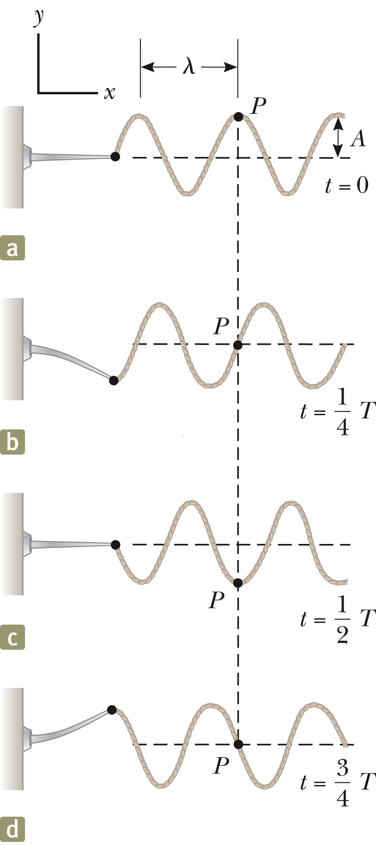
Sinusoidal Wave on a String
To create a series of pulses, the string can be attached to an oscillating blade.
The wave consists of a series of identical waveforms.
The relationships between speed, velocity, and period hold.
Section 16.2

Slide 26
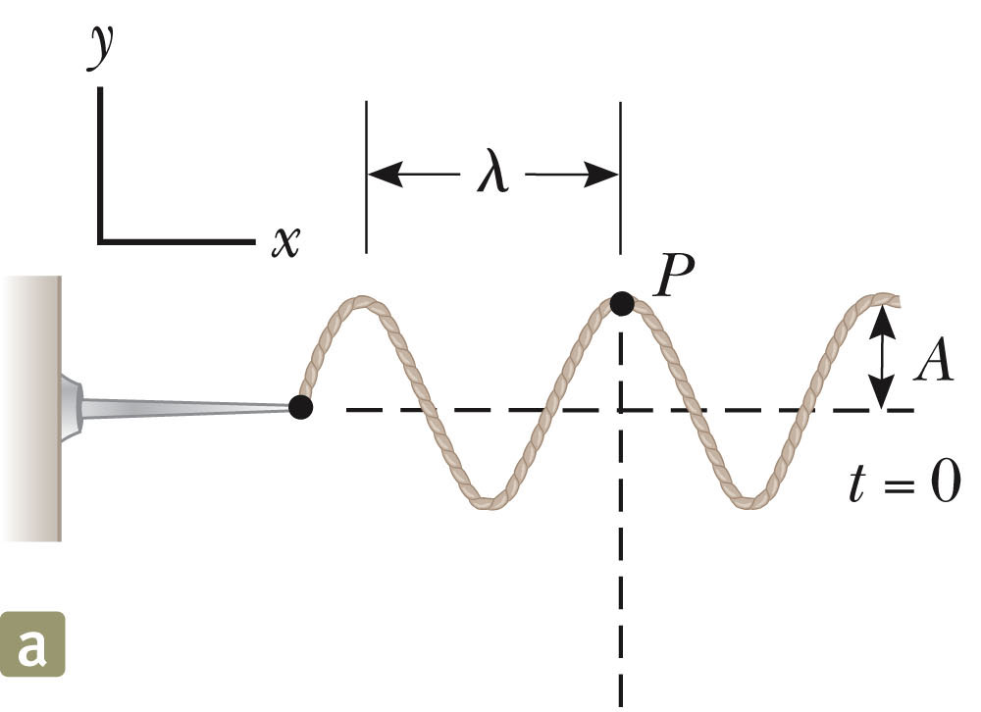
Sinusoidal Wave on a String, 2
Each element of the string oscillates vertically with simple harmonic motion.
  For example, point P
Every element of the string can be treated as a simple harmonic oscillator vibrating with a frequency equal to the frequency of the oscillation of the blade.
While each element oscillates in the y direction, the wave travels in the x direction with a speed v.
At t = 0, y = A sin (k x – ω t)
Section 16.2

Slide 27
Sinusoidal Wave on a String, 3
The transverse speed of the element is
or v_{y} = -ω A cos (kx – ωt)
This is different than the speed of the wave itself.
The transverse acceleration of the element is
or a_{y} = -ω²A sin(kx – ωt)
Section 16.2

Slide 28
Sinusoidal Wave on a String, final
The maximum magnitudes of the transverse speed and transverse acceleration are
  v_{y}, _{max} = ω A
  a_{y}, _{max} = ω² A
The transverse speed and acceleration do not reach their maximum values simultaneously.
  v is a maximum at y = 0
  a is a maximum at y = ±A
The speed of the wave, v, with the transverse velocity of a point on the string, v_{y.}
  The speed v is constant for a uniform medium, whereas v_{y} varies sinusoidally.
Section 16.2

Slide 29
Speed of a Wave on a String
The speed of the wave depends on the physical characteristics of the string and the tension to which the string is subjected.
This assumes that the tension is not affected by the pulse.
This does not assume any particular shape for the pulse.
Section 16.3

Slide 30
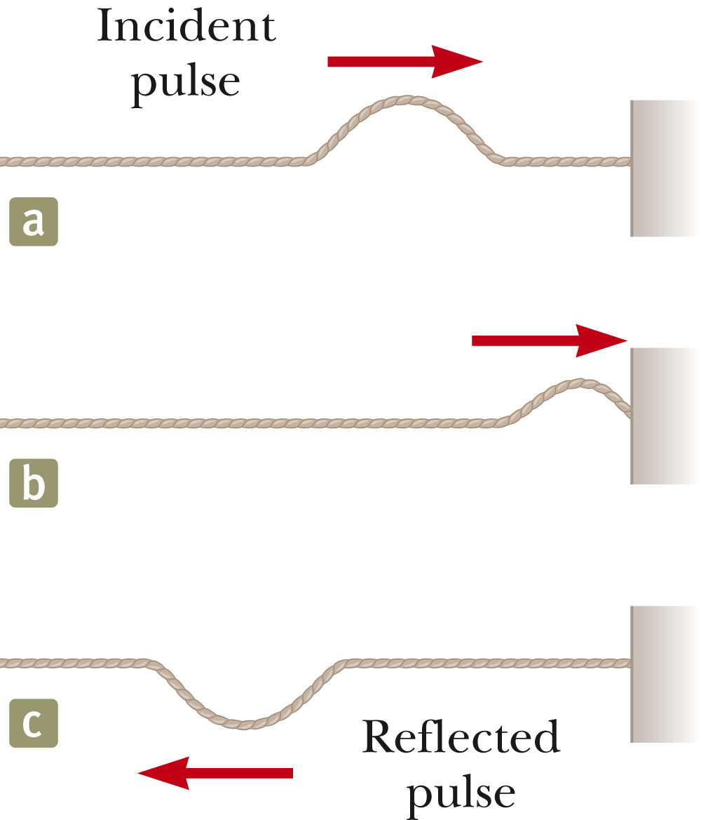
Reflection of a Wave, Fixed End
When the pulse reaches the support, the pulse moves back along the string in the opposite direction.
This is the reflection of the pulse.
The pulse is inverted.
  Due to Newton’s third law
    When the pulse reaches the fixed end of the string, the string produces an upward force on the support.
    The support must exert an equal-magnitude and oppositely directed reaction force on the string.
Section 16.4

Slide 31
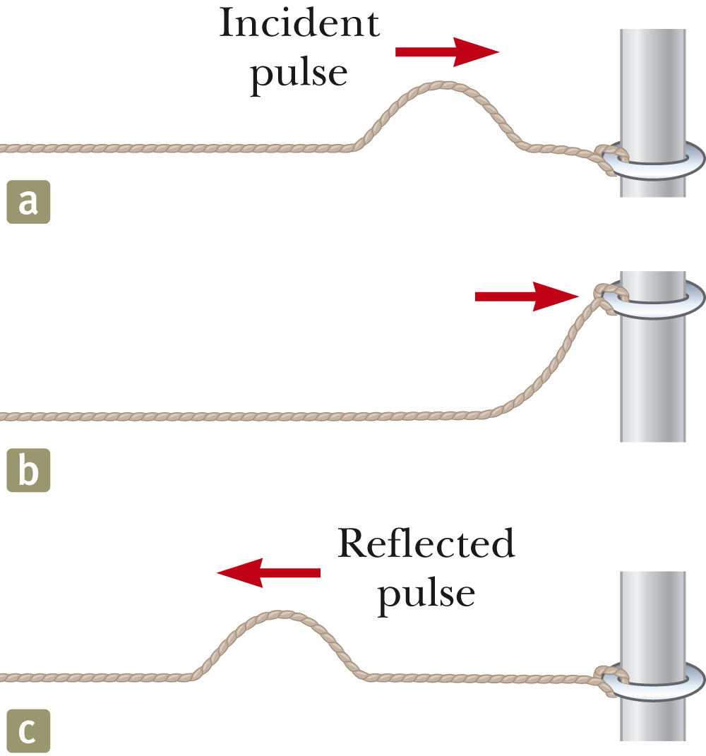
Reflection of a Wave, Free End
With a free end, the string is free to move vertically.
The pulse is reflected.
The pulse is not inverted.
The reflected pulse has the same amplitude as the initial pulse.
Section 16.4

Slide 32
Transmission of a Wave
When the boundary is intermediate between the last two extremes.
  Part of the energy in the incident pulse is reflected and part undergoes transmission.
    Some energy passes through the boundary.
Section 16.4

Slide 33
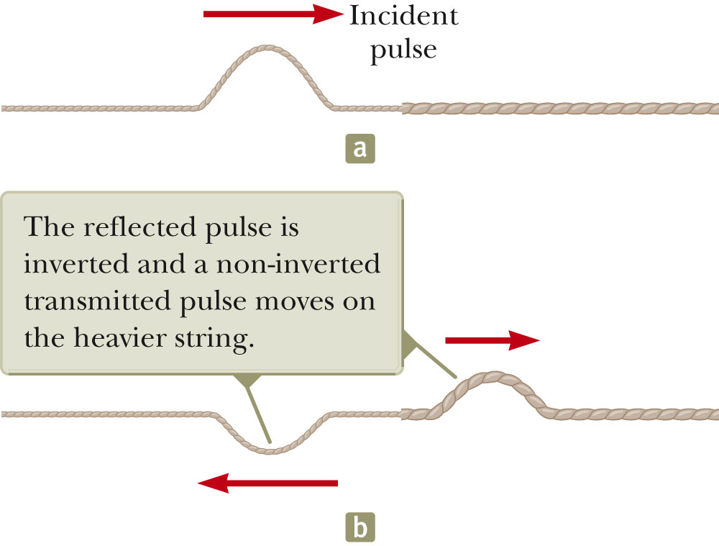
Transmission of a Wave, 2
Assume a light string is attached to a heavier string.
The pulse travels through the light string and reaches the boundary.
The part of the pulse that is reflected is inverted.
The reflected pulse has a smaller amplitude.

Slide 34
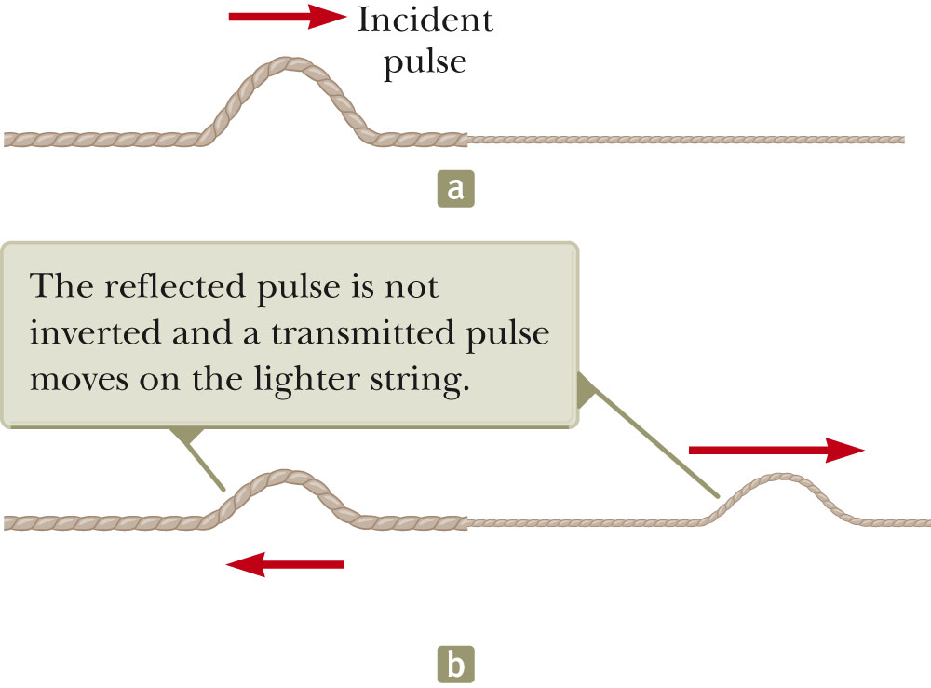
Transmission of a Wave, 3
Assume a heavier string is attached to a light string.
Part of the pulse is reflected and part is transmitted.
The reflected part is not inverted.
Section 16.4

Slide 35
Transmission of a Wave, 4
Conservation of energy governs the pulse
  When a pulse is broken up into reflected and transmitted parts at a boundary, the sum of the energies of the two pulses must equal the energy of the original pulse.
When a wave or pulse travels from medium A to medium B and v_{A} > v_{B}, it is inverted upon reflectio.n
  B is denser than A.
When a wave or pulse travels from medium A to medium B and v_{A} < v_{B}, it is not inverted upon reflection.
  A is denser than B.
Section 16.4

Slide 36
Energy in Waves in a String
Waves transport energy when they propagate through a medium.
We can model each element of a string as a simple harmonic oscillator.
  The oscillation will be in the y-direction.
Every element has the same total energy.
Each element can be considered to have a mass of dm.
The kinetic energy associated with the up and down motion of the element is dK = ½ (dm) v_{y}².
The mass dm is also equal to μdx.
The kinetic energy of an element of the string is dK = ½ (μ dx) v_{y}².
Section 16.5

Slide 37
Energy, cont.
Integrating over all the elements, the total kinetic energy in one wavelength is K_{λ} = ¼μ ω²A ²λ.
The total potential energy in one wavelength is U_{λ} = ¼μ ω²A ²λ.
This gives a total energy of
  E_{λ} = K_{λ} + U_{λ} = ½μ ω²A ²λ
Section 16.5

Slide 38
Power Associated with a Wave
The power is the rate at which the energy is being transferred:
The power transfer by a sinusoidal wave on a string is proportional to the
  Square of the frequency
  Square of the amplitude
  Wave speed
The rate of energy transfer in any sinusoidal wave is proportional to the square of the angular frequency and to the square of the amplitude.
Section 16.5

Slide 39
The Linear Wave Equation
The wave functions y (x, t) represent solutions of an equation called the linear wave equation.
This equation gives a complete description of the wave motion.
From it you can determine the wave speed
The linear wave equation is basic to many forms of wave motion.
Section 16.6

Slide 40
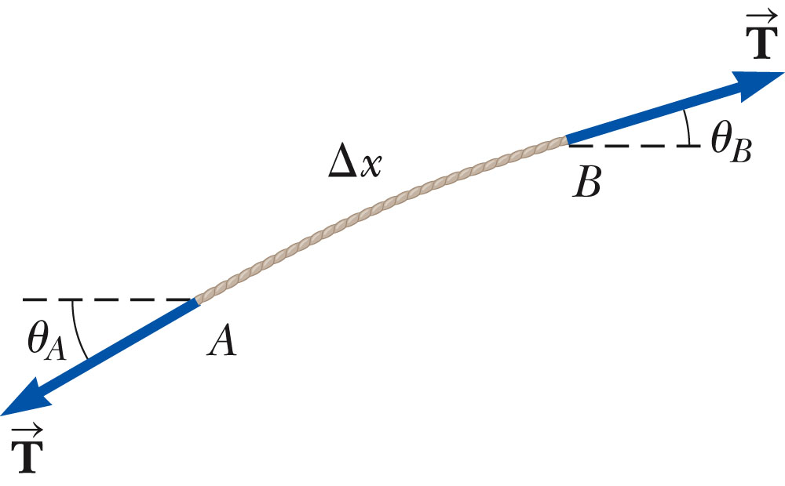
Linear Wave Equation Applied to a Wave on a String
The string is under tension T.
Consider one small string element of length Δx.
The net force acting in the y direction is
.
  This uses the small-angle approximation that sin θ ≈ tan θ.
Section 16.6

Slide 41
Linear Wave Equation Applied to Wave on a String, cont.
Applying Newton’s Second Law gives
In the limit as Δx→0, this becomes
This is the linear wave equation as it applies to waves on a string.
Section 16.6

Slide 42
Linear Wave Equation, General
The equation can be written as
This applies in general to various types of traveling waves.
  y represents various positions.
    For a string, it is the vertical displacement of the elements of the string.
    For a sound wave propagating through a gas, it is the longitudinal position of the elements of the gas from the equilibrium position.
    For electromagnetic waves, it is the electric or magnetic field components.
Section 16.6

Slide 43
Linear Wave Equation, General cont
The linear wave equation is satisfied by any wave function having the form
y = f (x ± vt)
The linear wave equation is also a direct consequence of Newton’s Second Law applied to any element of a string carrying a traveling wave.
Section 16.6

